Slide 1


Poornima College of Engineering
B. Tech. II Year (III Semester)
NSP –I Phase Presentation
Session: 2021-22
Project Title: Virtual Try-on
Submitted By: 3CSC5
Tripti Agrawal ,PCE20CS187, 20EPCCS195
Shitanshu Goyal , PCE20CS173, 20EPCCS174
Vikram Jangir, PCE20CS192,20EPCCS801
Project Guide: Ms Barkha Narang
Submitted To: Ms Barkha Narang

Slide 2
Abstract
The virtual try-on system uses a unique capture device and an artificial intelligence (AI)-driven way to digitize items of clothing. In this project Virtual Try-On new AR and VR technologies have been developed, which form the basis for a realistic, three dimensional, (real-time) simulation and visualization of individualized garments put on by virtual counterparts of real customers. To provide this cloning and dressing of people in VR, a complete process chain is being build up starting with the touch- less 2-dimensional scanning of the human body up to a photo-realistic 2-dimensional presentation of the virtual customer dressed in the chosen pieces of clothing. The emerging platform for interactive selection and configuration of virtual garments, the "virtual shop", will be accessible in real fashion boutiques as well as over the internet, thereby supplementing the conventional distribution channels.

Slide 3
Literature Review
Virtual Reality
The commonly accepted definition for VR is the use of computer-generated 3D environment, that the user can navigate and interact with, resulting in real-time simulation.
More specifically, the three key elements that characterize VR are:
Visualization
Immersion
Interactivity

Slide 4
Literature Review
Augmented Reality
AR can generally be defined as the enhancement of a real-world environment using layers of computer-generated images through a device
Increases engagement and interaction
Overlay of real and digital world
Registration and alignment in 3d
provides a richer user experience

Slide 5
Literature Review
Artificial Intelligence
The virtual try-on system uses a unique artificial intelligence (AI)-driven way to digitize items of clothing.
Using a corresponding imaging and display system
A user can then view themself on a screen wearing anything from the digital wardrobe.
An AI engine synthesizes photorealistic images, allowing movement and details.

Slide 6
Oriflame is one of the best examples when it comes to virtual try-on makeup. The Oriflame app enables users to try on lipstick, eyeliner, blush, mascara, and eyeshadow virtually so they can see exactly how the various makeup products look on them instantly. This enables easy and effective shopping that couples convenience and satisfaction because women know how it looks on them prior to their purchase.
The virtual try-on for glasses is another example of augmented reality in use. Lenskart and VirTry are two examples of using augmented reality to try-on glasses and sunglasses. The eyewear industry is changing so people can try on different frames for glasses and sunglasses from the comfort of their homes. People have shown a positive response, which means the eyewear industry is likely to change its path so it can offer more such experiences to the customers
Baume is a watchmaking brand that stepped into the virtual try-on bandwagon and has reaped benefits by doing so. The Swiss watchmaker provides a customization option to customers and allows them to try on the customised watches. This has allowed customers to know how the customised watch looks on their wrist so they can make changes if required and get the watch of their dreams.
Clothing is another industry where virtual try-on has proved to be a major success. Amazon is planning to launch virtual try-on clothes so customers can try before they buy from Amazon. Zeekit enables customers to try clothing online with the help of virtual images. Another example is Style.me where customers can create avatars and see how clothes fit on them. The fashion industry is quickly transitioning to provide AR technology through virtual fitting rooms.

Slide 7
Problem Statement & Objective
Technology has weaved its way into every sphere of life and shopping is no exception. They use technology to compare and ultimately decide what they will buy. our project falls under the category of augmented reality, virtual reality, and AI.
All this is done virtually with the help of a phone, laptop, or other devices that capture the image in real-time. Virtually trying on items allows customers to know exactly how something looks on them. Whether it is shoes or a piece of jewelry, virtually trying on products enables customers and retailers to connect without the barrier of customers coming to a physical store for shopping

Slide 8
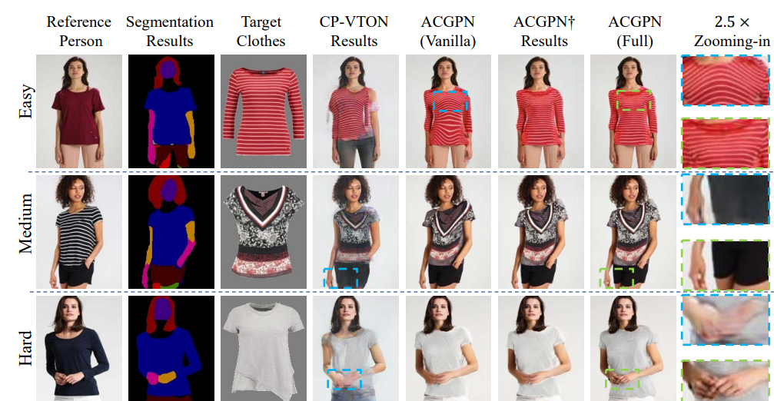
Screenshots

Slide 9
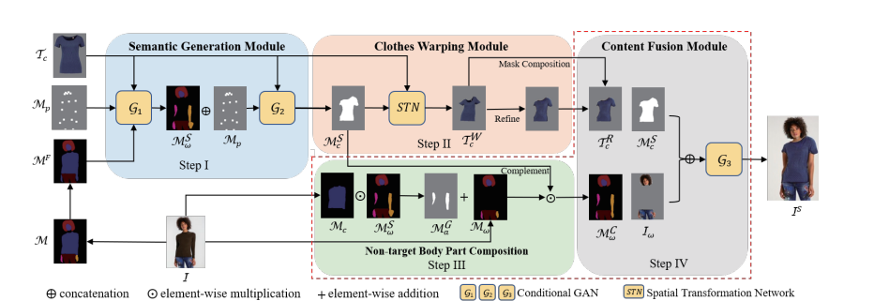
Screenshots

Slide 10
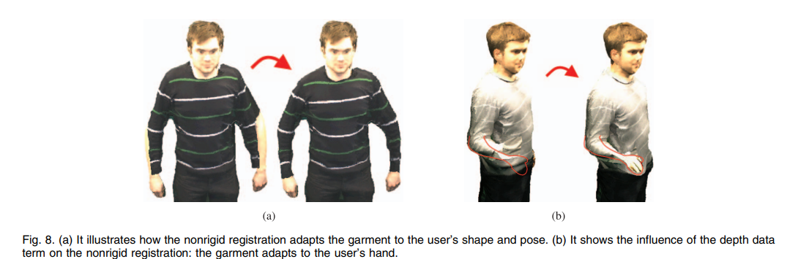
Screenshots

Slide 11
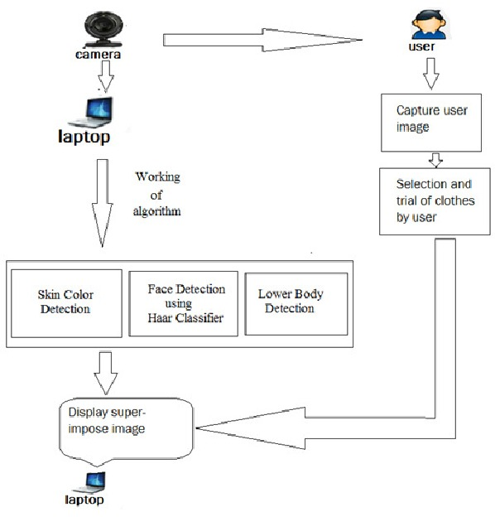
Processed Approach

Slide 12
References
List of Research papers for this project work.

Slide 13

Thanks & QA

